Slide 1
Kingdom of Saudi Arabia King Abdul Aziz University Faculty of Engineering
MENG 490
Strategic management and Leadership skills
Team # G2
Strategic planning
Tasks | Academic ID | Student Name
Leader | 0704657 | Sultan Talal Aqeel
Facilitator | 0704672 | Abdulmajeed Ali Hammas
Motivator | 0611169 | Hythum Adnan Qari
Time keeper | 0612806 | Ahmad Saeed Al-Hazmi
Spoke person | 0704611 | Husam Abed Al hothaly
Member | 0711726 | Amjad Gharamallah AlGhamdi
Spring 2010
Section : FA & FB

Slide 2
Presentation Agenda
Time | Task | Time | Task
10 min | 9- ambition. | 5 min | 1- worm up activity .
30 min | 10- break | 5 min | 2-story of success.
10 min | 11- activity. | 15 min | 3-strategic management.
15 min | 12- vision. | 15 min | 4- participation activity
10 min | 13- wisdoms and lessons. | 15 min | 5-strategic planning.
10 min | 14- vision levels. | 10 min | 6-story of success 2
10 min | 15- vision in logos. | 7 min | 7- participation activity 2.
10 min | 16- activity. | 5 min | 8- observations.
10 min | 17- summary .

Slide 3
Presentation contents
9- ambition. | 1- worm up activity .
10- activity. | 2-story of success.
11- vision. | 3-strategic management.
12- wisdoms and lessons. | 4- participation activity
13- vision levels. | 5-strategic planning.
14- vision in logos. | 6-story of success 2.
15- activity. | 7- participation activity 2.
16- summary . | 8- observations.

Slide 4
Worm up Activity
Birthday
Cake

Slide 5
Birthday
Cake

Slide 6
Revision for the previous session

Slide 7
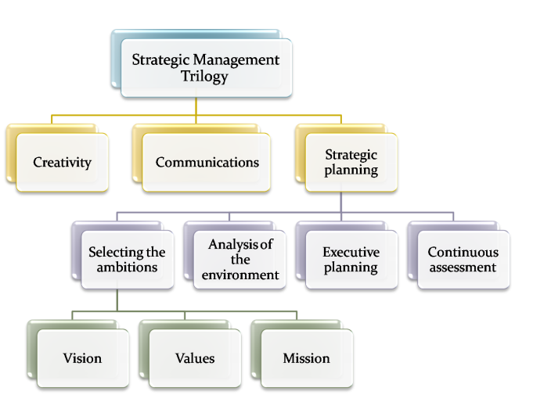
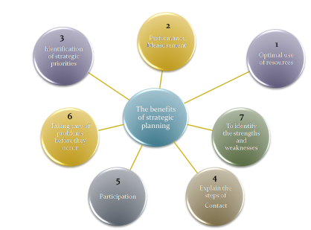
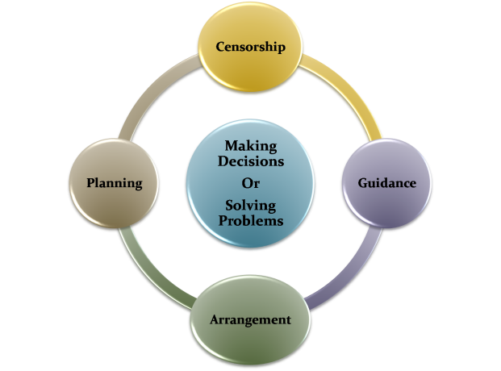
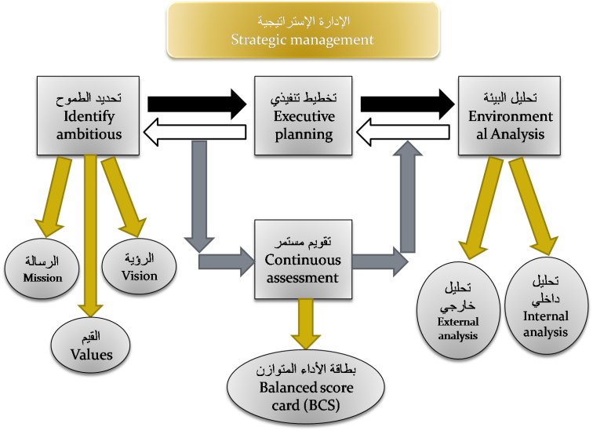
A story of success ?? عبدالرحمن الداخل (صقر قريش)
Participation Activity1 وجبة تفكيرية
What is the Management ??
Strategic Planning
Strategic Planning
The Planning process

Slide 8
A story of success 2 ?? Nicolas vujicic
Participation Activity 2 وجبة تفكيرية
Loosing
Advice

Slide 9
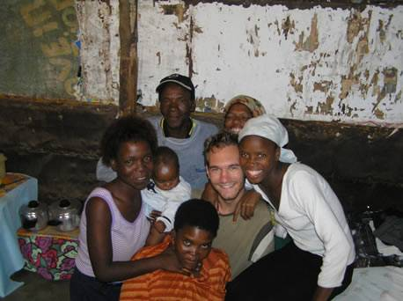
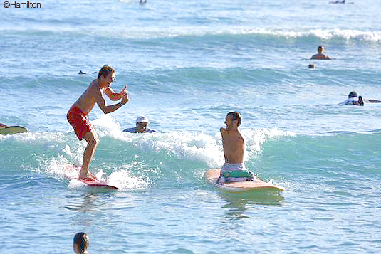
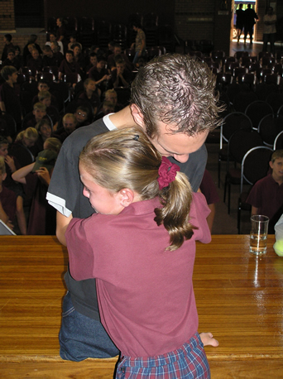
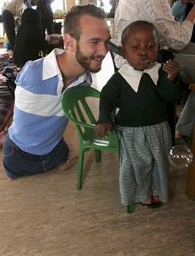
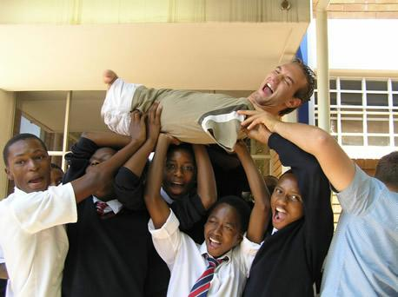

Slide 10
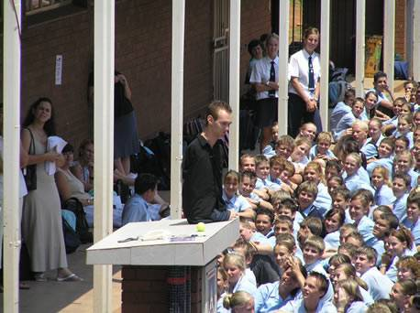
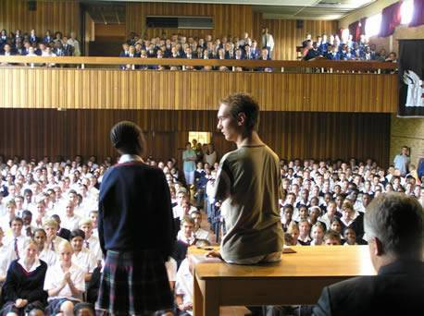
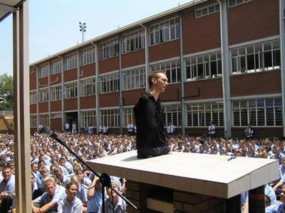
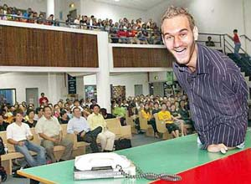

Slide 12
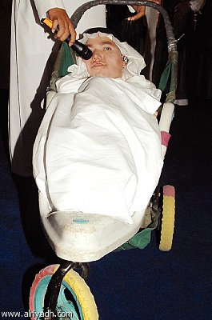

Slide 13
Ambition

Slide 16
Where I want to be? What are my future ambitions ???
Are my ambitions match my principal and values?
إذا لم تبني قلاعك في الهواء فلن تبنيها في أي مكان أخر ( مثل اسباني )
If u don’t build your constructions in the air, you’ll never build them anywhere. (Spanish speech)
إذا لم تكن تعرف إلى أي شيء تطمح فإنك تطمح إلى لا شيء
if u don’t know what is the direction of your ambitions, so your ambitions goes to nothing.

Slide 17
Vision
Values
Mission
Ambitious

Slide 18
Activity
Based on your knowledge, give a definition of each of the flowing :
Vision.
Values.
Mission.

Slide 19
Mission
The mission can be defined as the unique properties of the organization that specialize it from the others
هي الخصائص الفريدة للمنظمة التي تميزها عن غيرها من المنظمات.

Slide 20
Values
values are the organization's essential and enduring tenets a set of general guiding principles; not to be compromised financial gain or expediency.
القيم الأساسية للمنظمة هي مجموعة من المبادئ التوجيهية العامة ؛ لا يجوز المساس بها لتحقيق مكاسب مالية أو نفعية.

Slide 21
Vision
The vision can be defined as the visualize for the future orientation of the organization, so it expresses the dreams required to achieve.
هي تصور للتوجه المستقبلي للمنظمة، فهي تعبر عن الأحلام المطلوب تحقيقها.

Slide 22
Vision

Slide 23
I am the best doctor

Slide 24
New generation teacher

Slide 25
The richest man in the century

Slide 26
Simple Activity

Slide 29
The way to your vision is full of ……………..

Slide 32
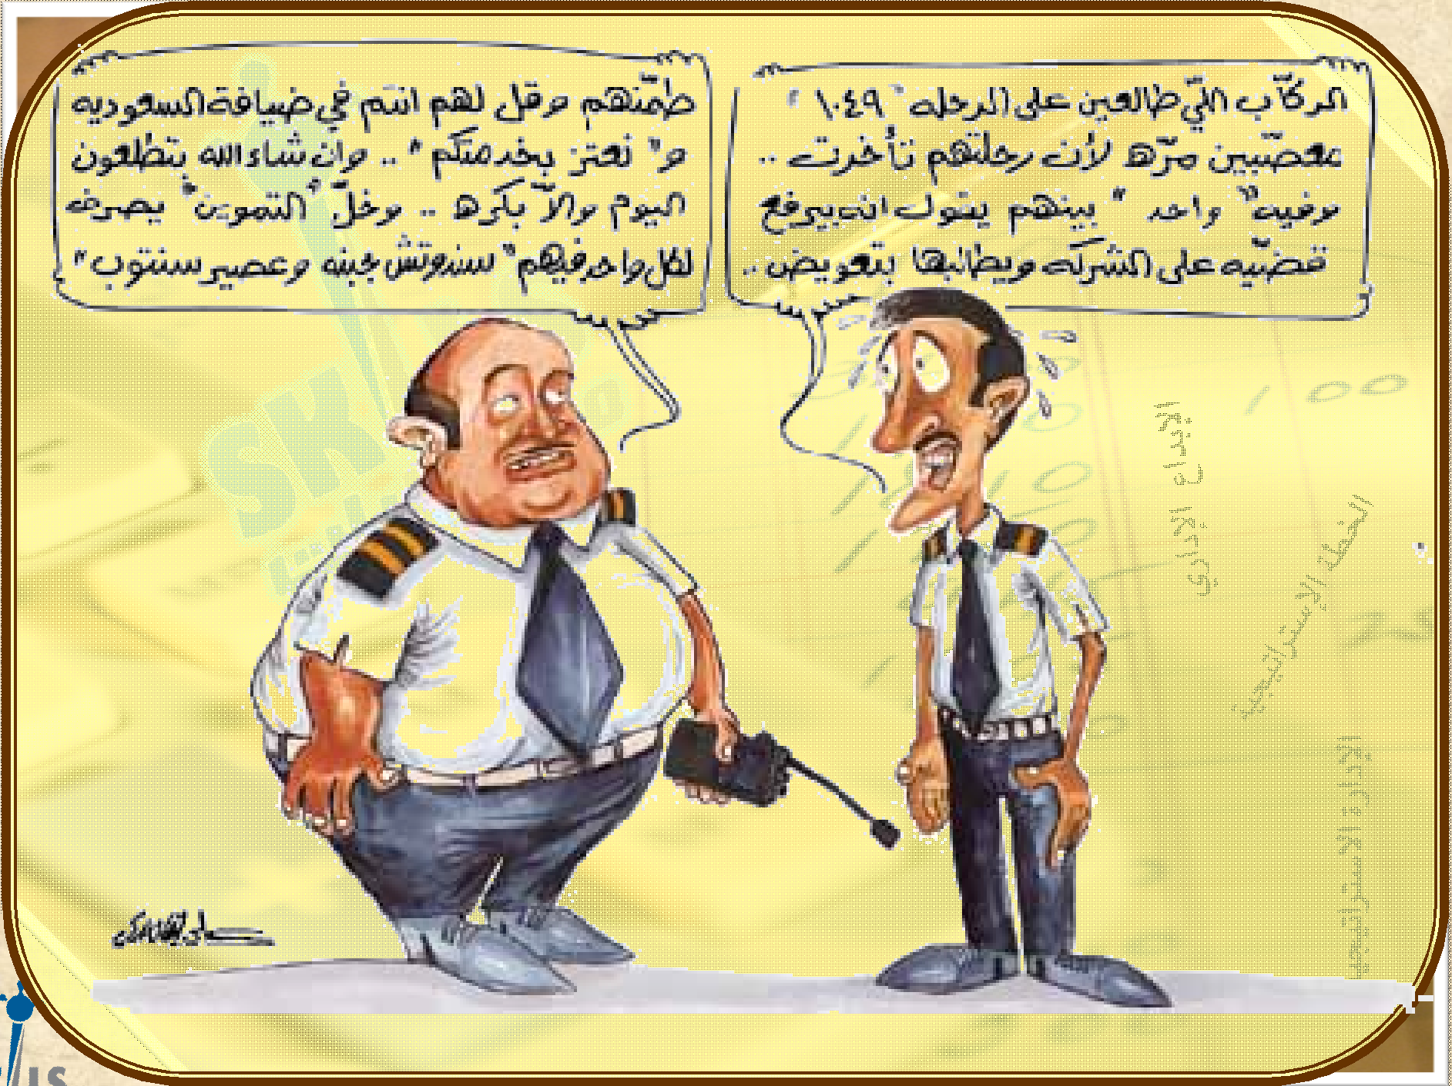

Slide 33
Wisdoms and lessons obtained

Slide 34
Life is full of stones …. I will not fall by them
But I will collect them and built a stairs to the success

Slide 35
Try to reach the top
If you look at the top you see
The crawdad..But there is
Always a place for a success people

Slide 36
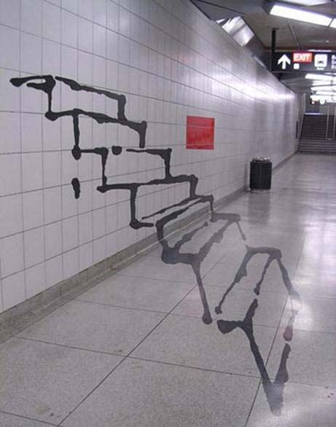
Reach your vision
Even if it’s too long but there is light at the end
Even if you draw your plan in the air

Slide 37
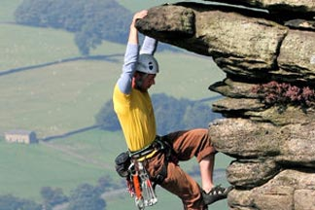
There is no failed man in this life, but there is a man who started from the bottom and remained there

Slide 44
Vision’s levels
vision
Strategic aim
Phase
aim
Phase
aim
Procedural
aim
Procedural
aim
Procedural
aim
Strategic aim : 5 years or more
Phase aim : 2 – 3 years
Procedural aim : 1 day – 1 week

Slide 45
رؤية الإسلام
إن رؤية الإسلام تتمثل في أن يرى كل مسلم الإسلام قد عمّ الأرض وانتشر فيها ولم يبقى موضع شبر فيها إلا وهو ينطق (لا اله إلا الله محمد رسول الله)
Islamic vision
The vision of Islam is to see this religion spread across the world and each part of it say
(لا اله إلا الله محمد رسول الله )

Slide 46
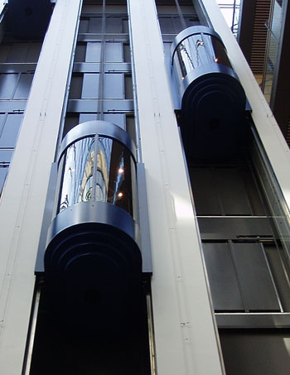
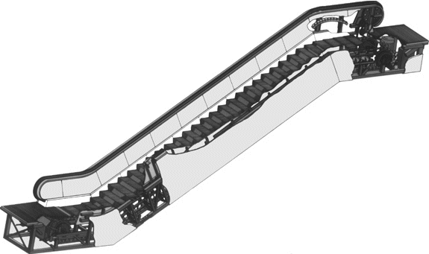
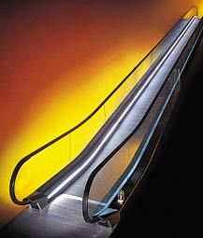
Otis elevator company vision
Our mission is to provide a client with the move people and things up, down, and to aspects of the short distances ,The highest degree of reliability and excellence

Slide 47
Microsoft company vision
There is one vision behind everything we do: A computer for every desk and in every house used our tool to achieve efficiency and values.

Slide 48
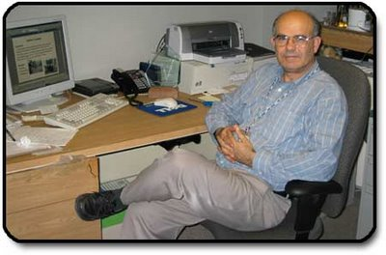
Palestinian Jalal Hawari
a pioneer in the use of bacteria to combat environmental pollution
Record 7 patents and 16 provided a study in organic chemistry

Slide 49
What would you do If you loss your fortune ????????

Slide 51
Oman's Mohammed Al Barwani, lost his fortune in construction translated into a global oil baron
Giants of the men of the world’s oil

Slide 52
Vision in logos
Classifications of logo’s
`
1st generation
2nd generation
3rd generation

Slide 53
Activity 2
Sort each of the fallowing logos under the proper classification ??

Slide 54
1st generation
2nd generation
3rd generation

Slide 55
Summary ????

Slide 56
A story of success ?? عبدالرحمن الداخل (صقر قريش)
Participation Activity1 وجبة تفكيرية
What is the Management ??
Strategic Planning
Strategic Planning
The Planning process

Slide 57
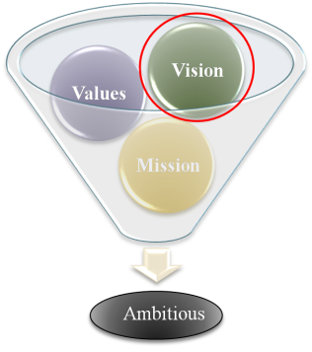
A story of success ?? Nicolas vujicic
Vision.
Values.
Mission.
Participation Activity1 وجبة تفكيرية
Vision
Loosing
Advice
The way to your vision is full of ……………..
Ambition
Wisdoms and lessons obtained

Slide 58
Vision’s levels
Examples
Vision in logos

Slide 59
Fill the evaluation form up

Slide 60
Question and discussion
?

