Slide 1
Kingdom of Saudi Arabia King Abdul Aziz University Faculty of Engineering
MENG 490
Strategic management and Leadership skills
Team # G2
Strategic planning
Tasks | Academic ID | Student Name
Leader | 0704657 | Sultan Talal Aqeel
Facilitator | 0704672 | Abdulmajeed Ali Hammas
Motivator | 0611169 | Hythum Adnan Qari
Time keeper | 0612806 | Ahmad Saeed Al-Hazmi
Spoke person | 0704611 | Husam Abed Al hothaly
Member | 0711726 | Amjad Gharamallah AlGhamdi
Spring 2010
Section : FA & FB

Slide 2
Presentation Agenda
Time | Task | Time | Task
10 min | 9- ambition. | 5 min | 1- worm up activity .
30 min | 10- break | 5 min | 2-story of success.
10 min | 11- activity. | 15 min | 3-strategic management.
15 min | 12- vision. | 15 min | 4- participation activity
10 min | 13- wisdoms and lessons. | 15 min | 5-strategic planning.
10 min | 14- vision levels. | 10 min | 6-story of success 2
10 min | 15- vision in logos. | 7 min | 7- participation activity 2.
10 min | 16- activity. | 5 min | 8- observations.
10 min | 17- summary .

Slide 3
Presentation contents
9- ambition. | 1- worm up activity .
10- activity. | 2-story of success.
11- vision. | 3-strategic management.
12- wisdoms and lessons. | 4- participation activity
13- vision levels. | 5-strategic planning.
14- vision in logos. | 6-story of success 2.
15- activity. | 7- participation activity 2.
16- summary . | 8- observations.

Slide 4
Worm up Activity

Slide 6
A story of success ??
عبدالرحمن الداخل (صقر قريش )

Slide 7
What is the Management ??
Management
Is the achievement of organizational objectives through people and other resources

Slide 8
Making Decisions
Or
Solving Problems
Censorship
Guidance
Arrangement
Planning

Slide 9
Strategic Management Trilogy
Creativity
Strategic planning
Selecting the ambitions
Communications
Analysis of the environment
Executive planning
Continuous assessment
Vision
Values
Mission

Slide 10
Active strategic management trilogy
The power points of the strategic manager are
Built by the philosophy of
Strategic planning
Provided by the skills of
Creative thinking
And Perfection of
Communications skills
CNS
Heart
Outer body

Slide 11
الإدارة الإستراتيجية
Strategic management
تحديد الطموح
Identify ambitious
تخطيط تنفيذي
Executive planning
تحليل البيئة
Environmental Analysis
تقويم مستمر
Continuous assessment
الرسالة
Mission
الرؤية
Vision
تحليل خارجي
External analysis
تحليل داخلي
Internal analysis
القيم
Values
بطاقة الأداء المتوازن
Balanced score card (BCS)

Slide 12
Participation Activity وجبة تفكيرية

Slide 13
تعريف التخطيط الاستراتيجي؟
Identify the strategic planning?
اكتب عنوان كل فائدة من فوائد التخطيط الاستراتيجي السبع في المكان الصحيح.
Write a title for each text of the strategic planning benefits in the right blank.

Slide 14
Strategic Planning
Strategic Planning
Is the detailed specification of both the long-term aims and the strategy for achieving them.

Slide 15
The benefits of strategic planning
Performance Measurement
Optimal use of resources
Identification of strategic priorities
Explain the steps of
Contact
To identify the strengths and weaknesses
Taking care of problems before they occur
Participation
2
3
1
7
6
5
4

Slide 16
Strategic Planning
The process of developing strategic actions to:
deploy company resources and competencies.
seize environmental opportunities.
confront threats
overcome and/or neutralize internal constraints and weaknesses.

Slide 17
The Planning process
Top management to set the stage for the process.
Arranging base data.
Performing the base analysis.
Performing the situation analysis.
Performing the gap analysis.
Developmental activities.
Designing the plan.
Plan evaluation and approval.
Implementation.
Review and updating.

Slide 18
A story of success 2 ??

Slide 19
Participation Activity 2 وجبة تفكيرية

Slide 20
لماذا التخطيط حاجة ضرورية على المستوى الشخصي؟
Why planning is necessary for you as a person ?
ما علاقة التخطيط الشخصي بالتخطيط المؤسسي؟
What is the relation between the personal planning and the corporate planning ?

Slide 21
Loosing
With lack of planning, that keeps many people lose their way to success and their goals, and with extra efforts with zero productivity, thus that’s when they give up everything.
إذا لم تبدأ من الآن فستحصد المزيد من الخسائر.
If you can’t start from now, then prepare for losing.
إذا فشلت في التخطيط فقد خططت للفشل.
If you failed in planning , then your planning was a failure.

Slide 22
Advice
خصص ساعة لتختلي فيها بنفسك فأنت بحاجة لساعة هادئة يوميا تفكر فيها في نفسك وحياتك وتتأمل فيها الكون من حولك وتبتكر بعض الأفكار. Devoted an hour to retire on your own, you need a calm hour every day to think about yourself and your life and contemplate the universe around you and create some ideas.

Slide 23
Ambition

Slide 26
Where I want to be? What are my future ambitions ???
Are my ambitions match my principal and values?
إذا لم تبني قلاعك في الهواء فلن تبنيها في أي مكان أخر ( مثل اسباني )
If u don’t build your constructions in the air, you’ll never build them anywhere. (Spanish speech)
إذا لم تكن تعرف إلى أي شيء تطمح فإنك تطمح إلى لا شيء
if u don’t know what is the direction of your ambitions, so your ambitions goes to nothing.

Slide 27
Vision
Values
Mission
Ambitious

Slide 28
Activity
Based in your knowledge, give a definition for
Vision.
Values.
Mission.

Slide 29
Mission
The mission can be defined as the unique properties of the organization that specialize it from the others
هي الخصائص الفريدة للمنظمة التي تميزها عن غيرها من المنظمات.

Slide 30
Values
values are the organization's essential and enduring tenets a set of general guiding principles; not to be compromised financial gain or expediency.
القيم الأساسية للمنظمة هي مجموعة من المبادئ التوجيهية العامة ؛ لا يجوز المساس بها لتحقيق مكاسب مالية أو نفعية.

Slide 31
Vision
The vision can be defined as the visualize for the future orientation of the organization, so it expresses the dreams required to achieve.
هي تصور للتوجه المستقبلي للمنظمة، فهي تعبر عن الأحلام المطلوب تحقيقها.

Slide 32
Vision

Slide 33
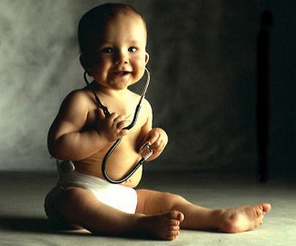
I am the best doctor

Slide 34
New generation teacher

Slide 35
The richest man in the century

Slide 36
Simple Activity

Slide 39
The way to your vision is full of ……………..

Slide 42
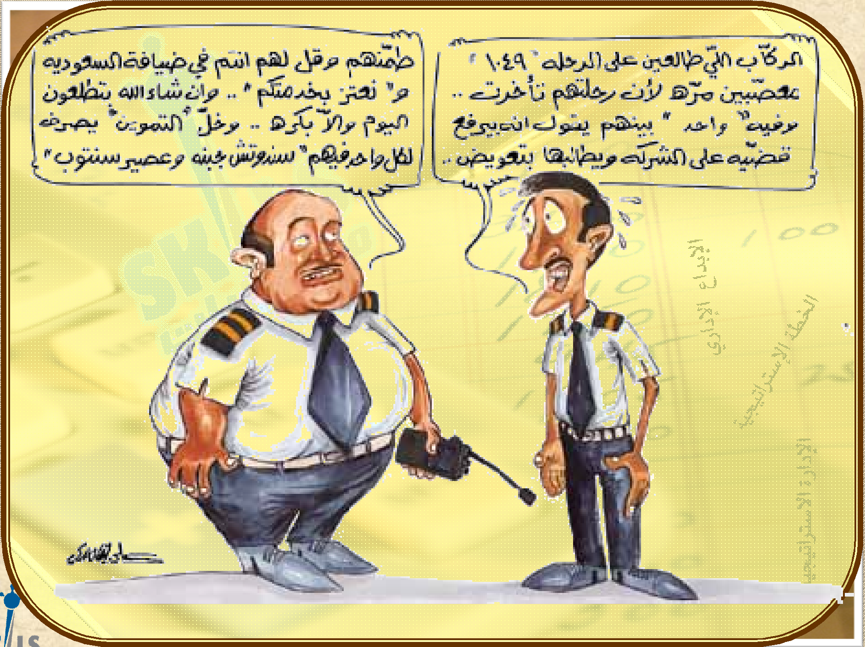

Slide 43
Wisdoms and lessons obtained

Slide 44
Life is full of stones …. I will not fall by them
But I will collect them and built a stairs to the success

Slide 45
Try to reach the top
If you look at the top you see
The crawdad..But there is
Always a place for a success people

Slide 46
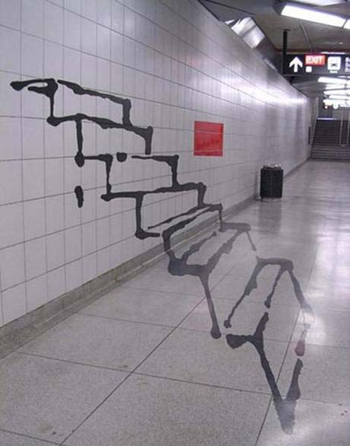
Reach your vision
Even if it’s too long but there is light at the end
Even if you draw your plan in the air

Slide 47
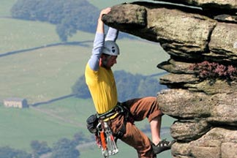
There is no failed man in this life, but there is a man who started from the bottom and remained there

Slide 54
Vision’s levels
vision
Strategic aim
Phase
aim
Phase
aim
Procedural
aim
Procedural
aim
Procedural
aim
Strategic aim : 5 years or more
Phase aim : 2 – 3 years
Procedural aim : 1 day – 1 week

Slide 55
رؤية الإسلام
إن رؤية الإسلام تتمثل في أن يرى كل مسلم الإسلام قد عمّ الأرض وانتشر فيها ولم يبقى موضع شبر فيها إلا وهو ينطق (لا اله إلا الله محمد رسول الله)
Islamic vision
The vision of Islam is to see this religion spread across the world and each part of it say
(لا اله إلا الله محمد رسول الله )

Slide 56
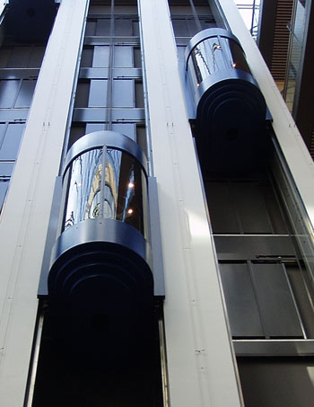
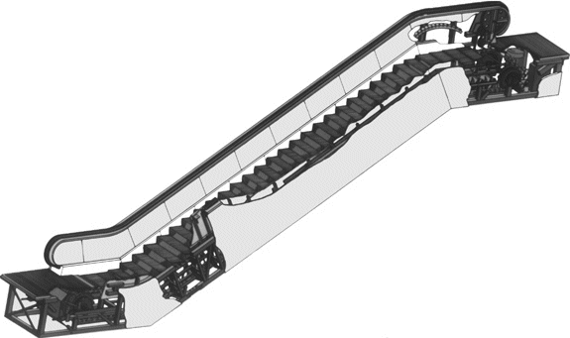
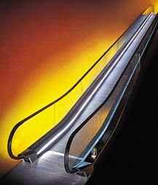
Otis elevator company vision
Our mission is to provide a client with the move people and things up, down, and to aspects of the short distances ,The highest degree of reliability and excellence

Slide 57
Microsoft company vision
There is one vision behind everything we do: A computer for every desk and in every house used our tool to achieve efficiency and values.

Slide 58
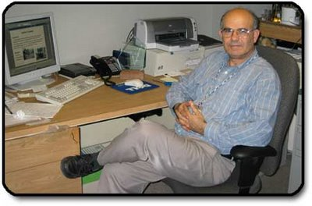
Palestinian Jalal Hawari
a pioneer in the use of bacteria to combat environmental pollution
Record 7 patents and 16 provided a study in organic chemistry

Slide 59
What would you do If you loss your fortune ????????

Slide 61
Oman's Mohammed Al Barwani, lost his fortune in construction translated into a global oil baron
Giants of the men of the world’s oil

Slide 62
Vision in logos
Classifications of logo’s
`
1st generation
2nd generation
3rd generation

Slide 63
Activity 2
Sort each of the fallowing logos under the proper classification ??

Slide 64
1st generation
2nd generation
3rd generation

Slide 65
Summary ????

